Slide 1
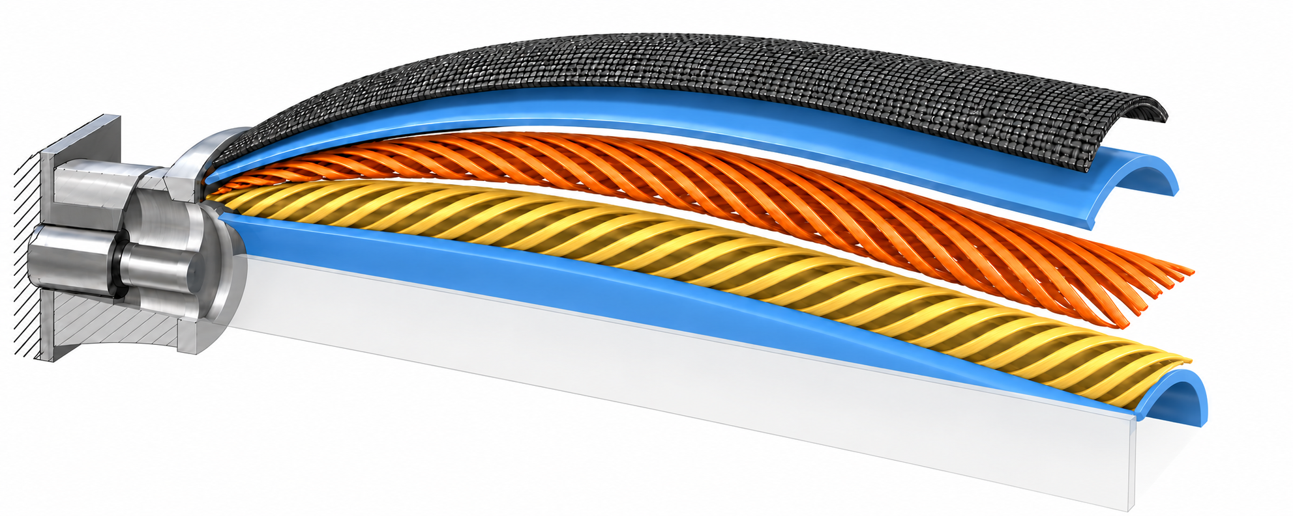
(B) Exploded half-cutaway
Fixed end cap
Fabric outer
covering
Outer rubber
Aramid helix (+θ)
Aramid helix (−θ)
Inner rubber
Longitudinal symmetry plane

